Slide 1
INF 560 - Project Presentation
Prediction model for liver transplantation surgery
Presented By:
Aibo Sun
Rasika Guru
Roshani Mangalore
Team Name: Insight
Date：May 3rd, 2018

Slide 2
Content
Elevator Pitch
Define Phase
Measure Phase
Analysis Phase
Improve Phase
Control Phase
Demo
Key Learnings
Future Work
References

Slide 3
Elevator Pitch
Approximately 14,000 patients are listed and waiting for orthotopic liver transplantation (OLT) but only 7,000 OLTs are performed annually[1].
There is a need to identify who the potential liver recipient is given that there are comparatively lesser number of liver donors.
Our predictive model not only determines the influential clinical features but also matches every donor with a potential recipient justified by graft survival rate
1

Slide 4
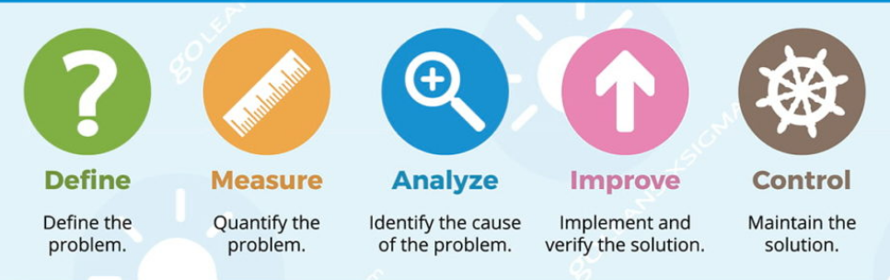
Project Milestone
Timeline
January
February
March
April 1- April 15th
April 15th – April 27th
Define
problem statement
Data Analysis and Exploration
Feature engineering
Implement Prediction Model and Matching algorithm
Measure/Improve the model performance
Visualize Data
Presentation and report
2

Slide 5

Project Objective
Our focus is to develop a predictive model for liver transplantation which:
Identifies the key clinical attributes that influences the identification of potential recipient
Identifies 5-best recipients for every donor based on the matching score between the donor and recipient.
If two recipients have the same matching score, graft survival probability is used to break the ties.
3

Slide 6
Project Scope
Perform preliminary data analysis on the available dataset
Perform data cleaning and feature engineering techniques
Identify key clinical attributes which influences the Identification of potential liver recipient
Implement matching algorithm to match every donor with the potential recipient
Develop a highly accurate model that predicts the graft survival probability of the potential recipient for the Liver Transplantation Surgery.
Develop a user-friendly web application to be used by Medical professionals
4

Slide 7
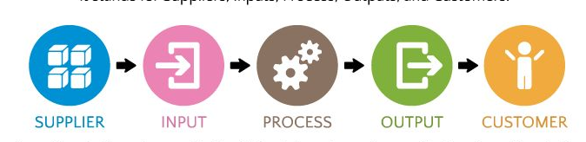
SIPOC
Suppliers
Inputs
Process
Outputs
Customers
USC Keck School of Medicine Professor Anna Farzindar | Liver transplant Patient dataset from Keck Medical Center of USC Research papers regarding liver transplantation Lean 6 sigma |  | Website with the following information Top clinical features influencing the identification of potential recipient Matching every Donor with the potential recipient Displaying matching score and probability of graft survival for every recipient | Keck Medical Center of USC UNOS Hospital management Surgeons, medical experts
Data Analysis and Exploration/ Features engineering
Documentation/Presentation/ Website
Measure/Improve the model performance
Observe /clean data
Implementing Prediction and Matching algorithm
Build the model
5

Slide 8
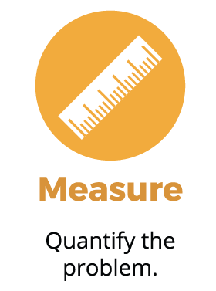
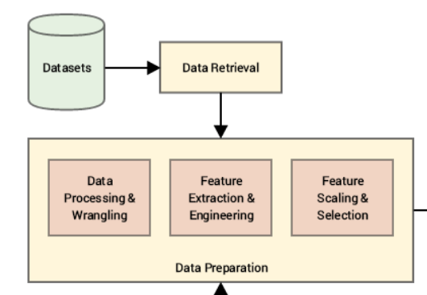
Data Preprocessing
6

Slide 9
Data Cleaning
Perform data cleaning to eliminate the attributes which do not contribute to the prediction analysis (Ex: Post Transplantation features, State of Residency, Education level of recipients)
Elimination of records where the age of recipient is below 18 years since this projects aims at dealing only with MELD score
Elimination of records where PTIME > GTIME marking the outliers or the noisy data
7

Slide 10
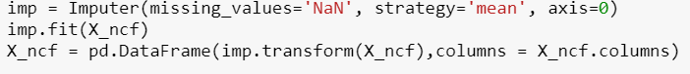
Feature Engineering
Handling missing values:
Replace NULL values in categorical columns with the mode
Replace NULL values with the mean for non- categorical features
8

Slide 11
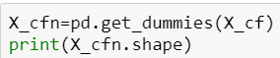
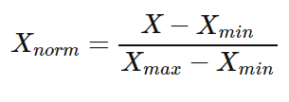
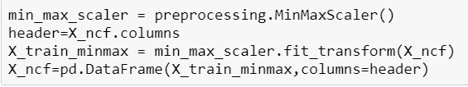
Feature Engineering
Perform one-hot encoding for Categorical features as Machine learning models accepts only numerical data
Perform feature scaling to standardize the range of independent variables or features of data. We have used Min-max scalar from scikit library,
9

Slide 12
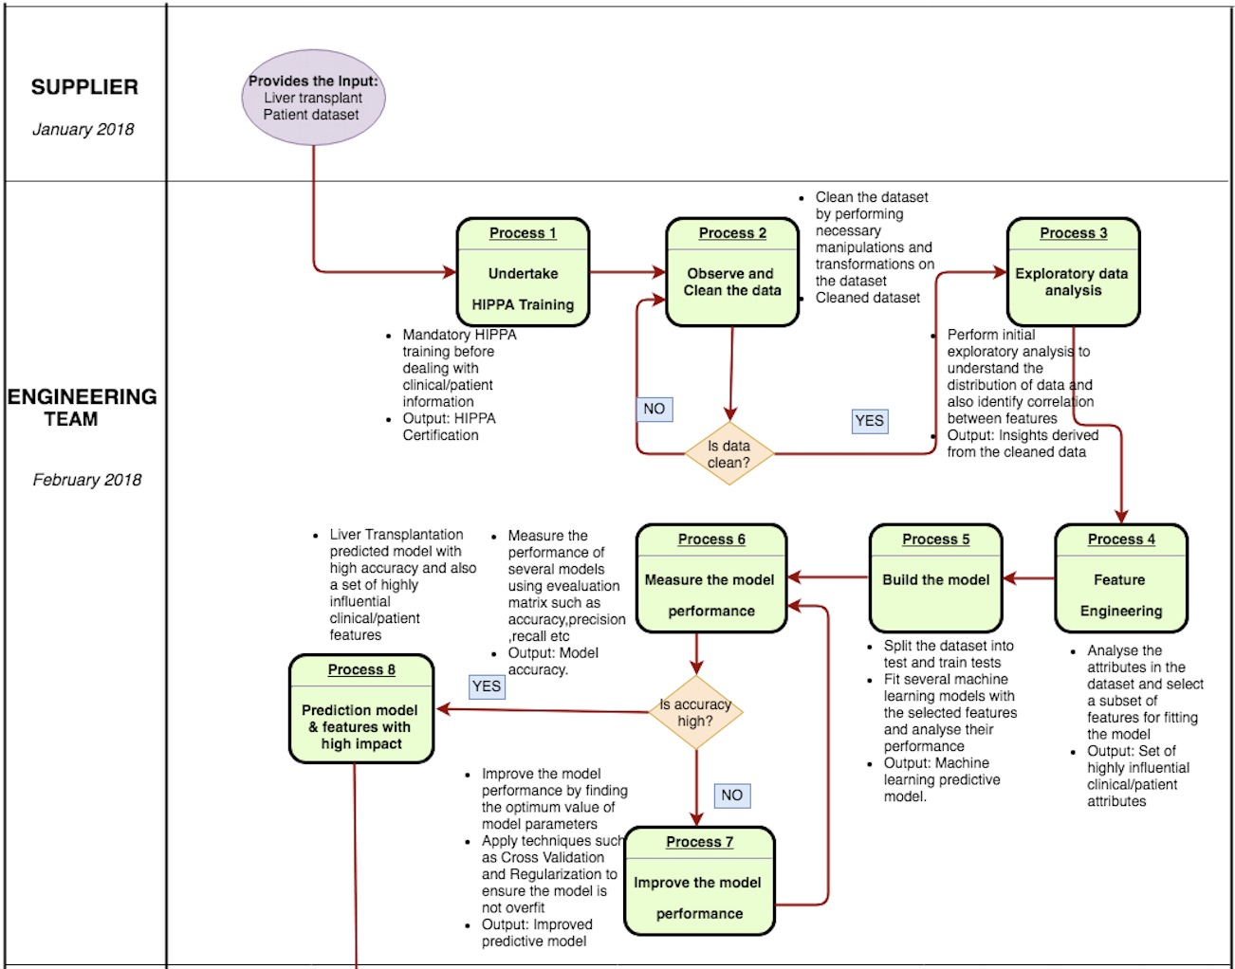
10

Slide 13
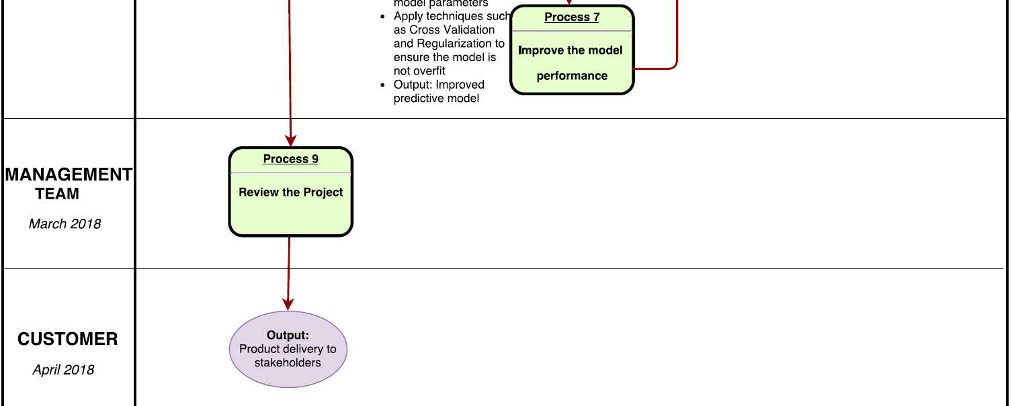
11

Slide 14
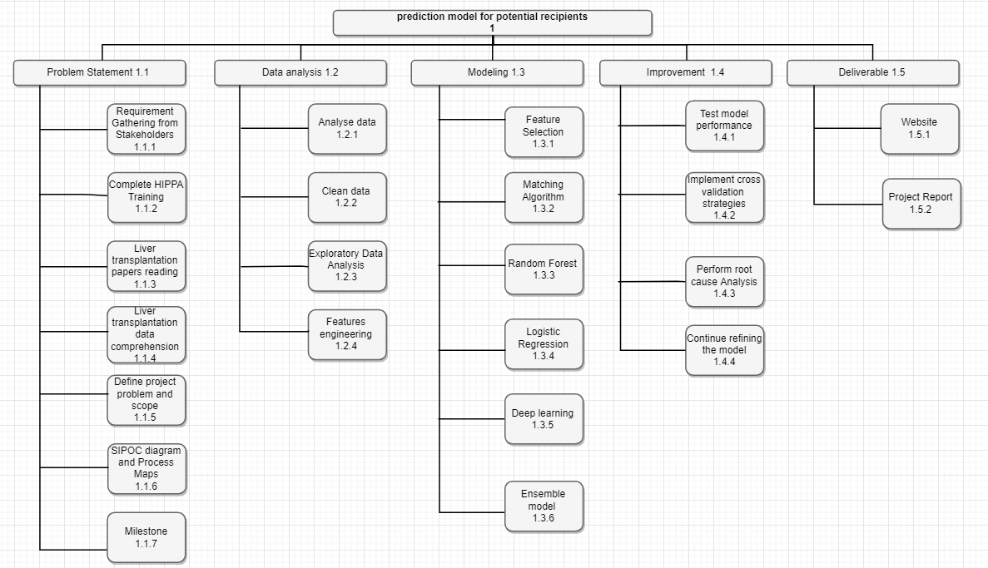
Work Breakdown Structure

Slide 15
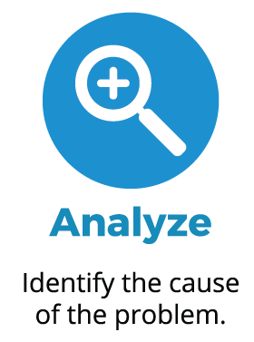

Data Analysis
13

Slide 16
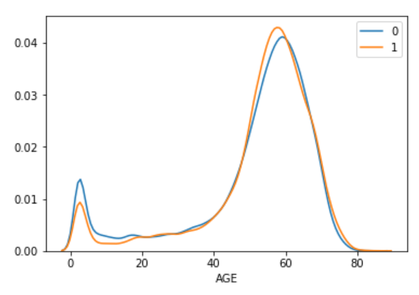
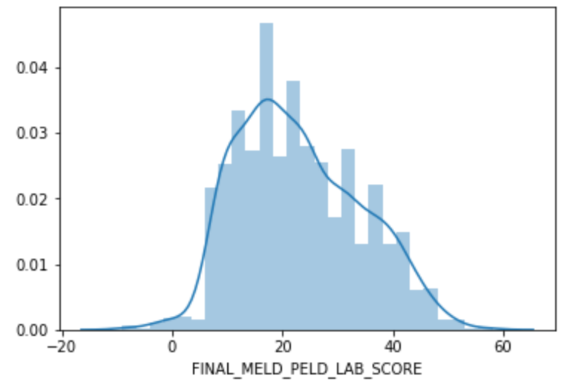
Data Analysis
GSTATUS Vs Age
MELD Score distribution
14

Slide 17
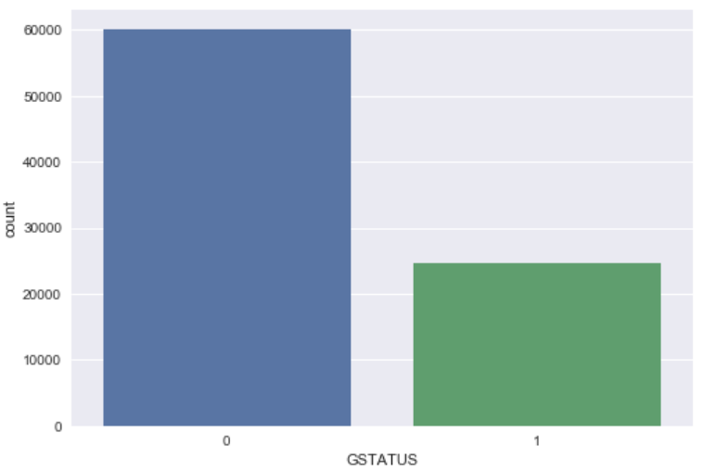
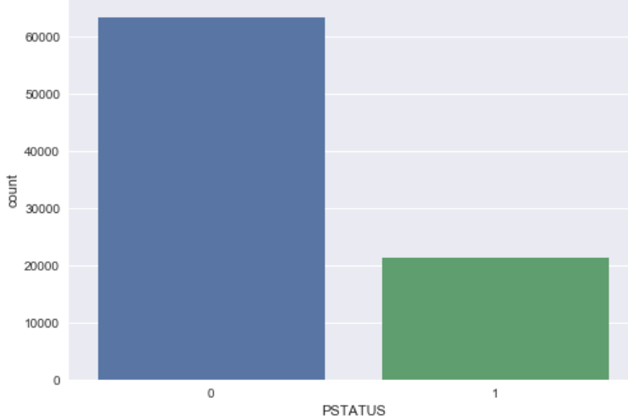
Data Analysis
GSTATUS
PSTATUS
15

Slide 18
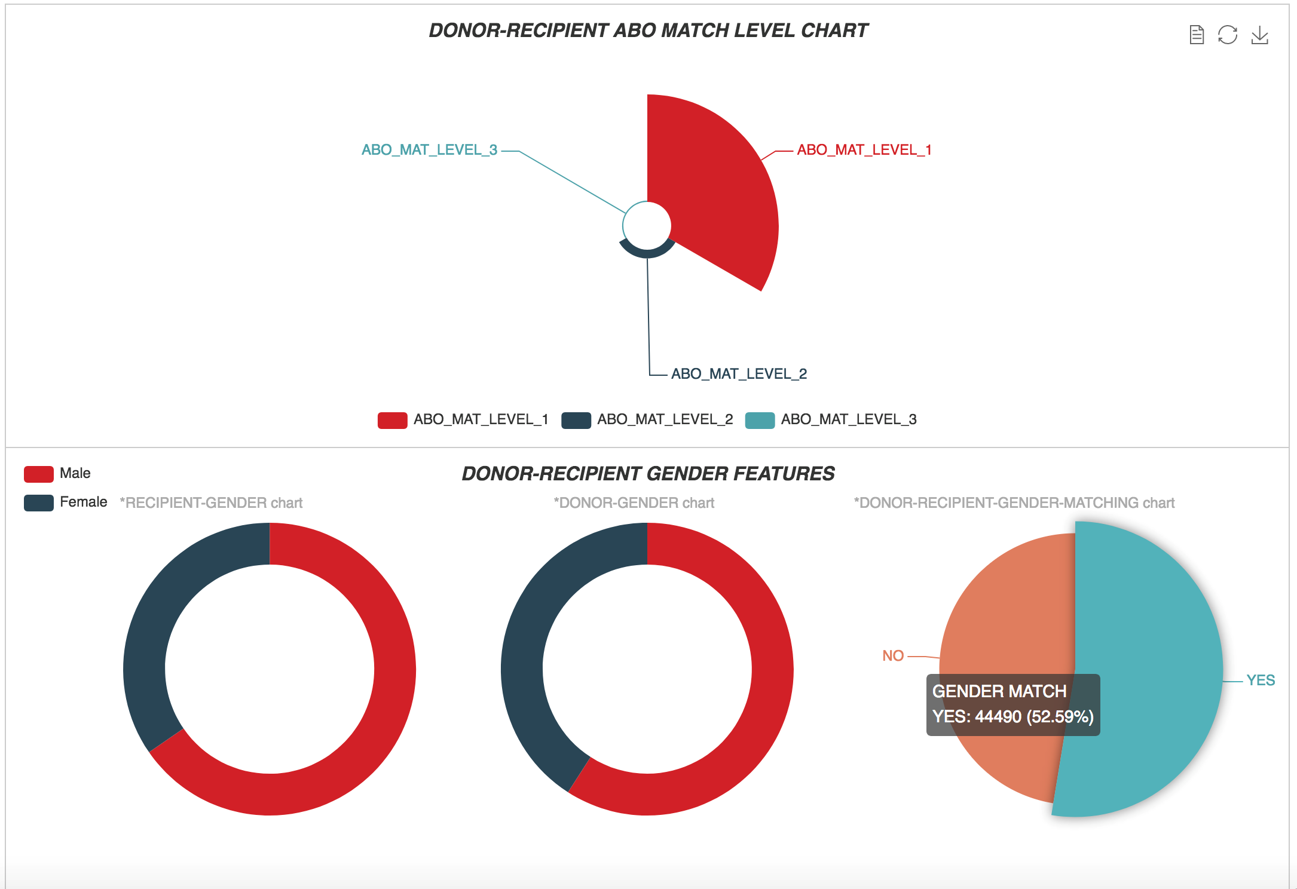
Data Analysis
16

Slide 19
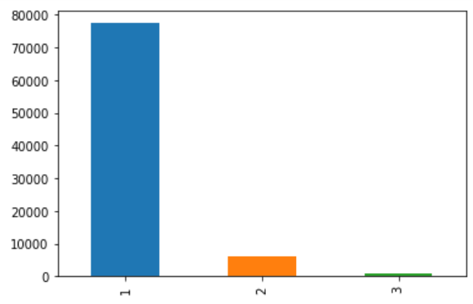
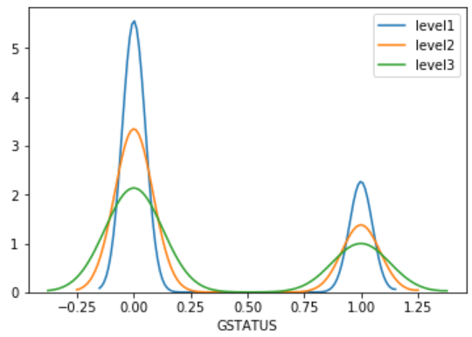
Data Analysis
DONOR-RECIPIENT ABO MATCH LEVEL is directly proportional to GSTATUS
17

Slide 20
Part 2: Feature Selection
18

Slide 21
Feature Selection
Univariate Statistics features selection
Determines the relationship between each feature and output(target)
Only the features with highest confidence are selected
Select Percentile : 75 % of the features
Random Forest Classifier and Select from Model
Cross Validation is incorporated to increase the accuracy of the model
Output : The common top features selected by both the Models
Univariate Statistics and Random Forest classifier has 41 features in common with zero importance and these features have been eliminated before fitting the Models
19

Slide 22
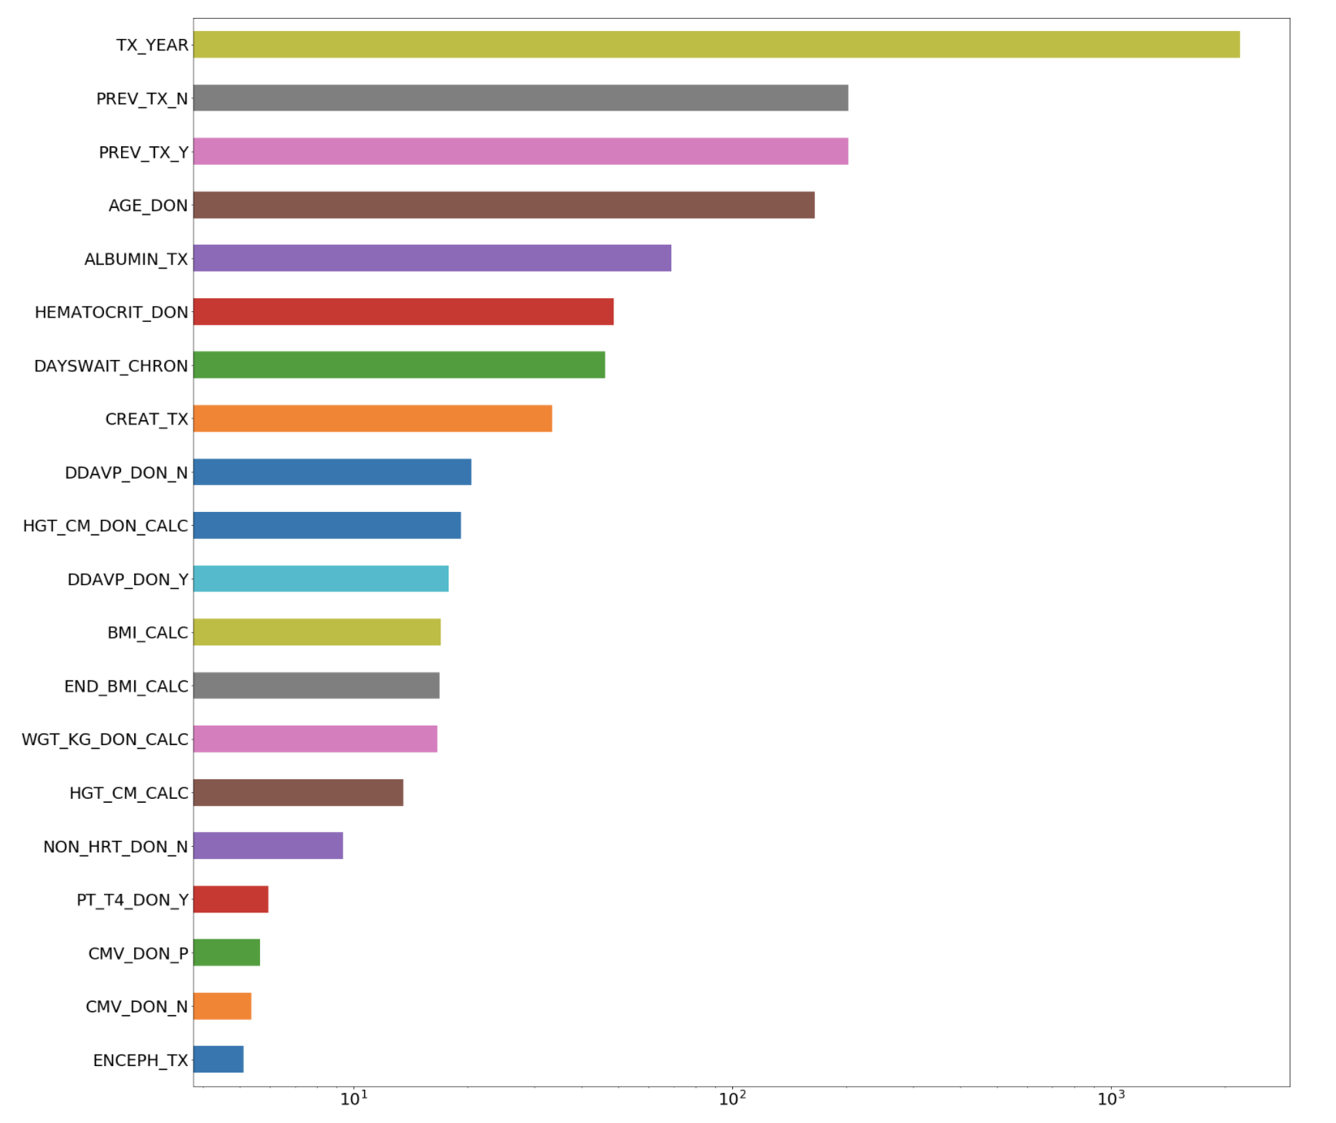
Top 20 Important Features
20

Slide 23
Part 3: Matching
21

Slide 24
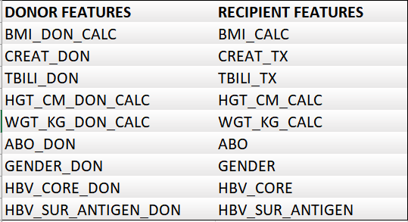
Matching Donor with Potential Recipient
22

Slide 25
Matching Donor with Potential Recipient
The correlation of the independent common features with the target variable is calculated using Chi square test (for categorical features) and student-t test (for continuous features).
The metric is then established by incorporating weights to the score corresponding to the correlation.
The 5- best recipients for every donor is chosen and the potential recipient is then identified by the probability of the graft success rate
23

Slide 26
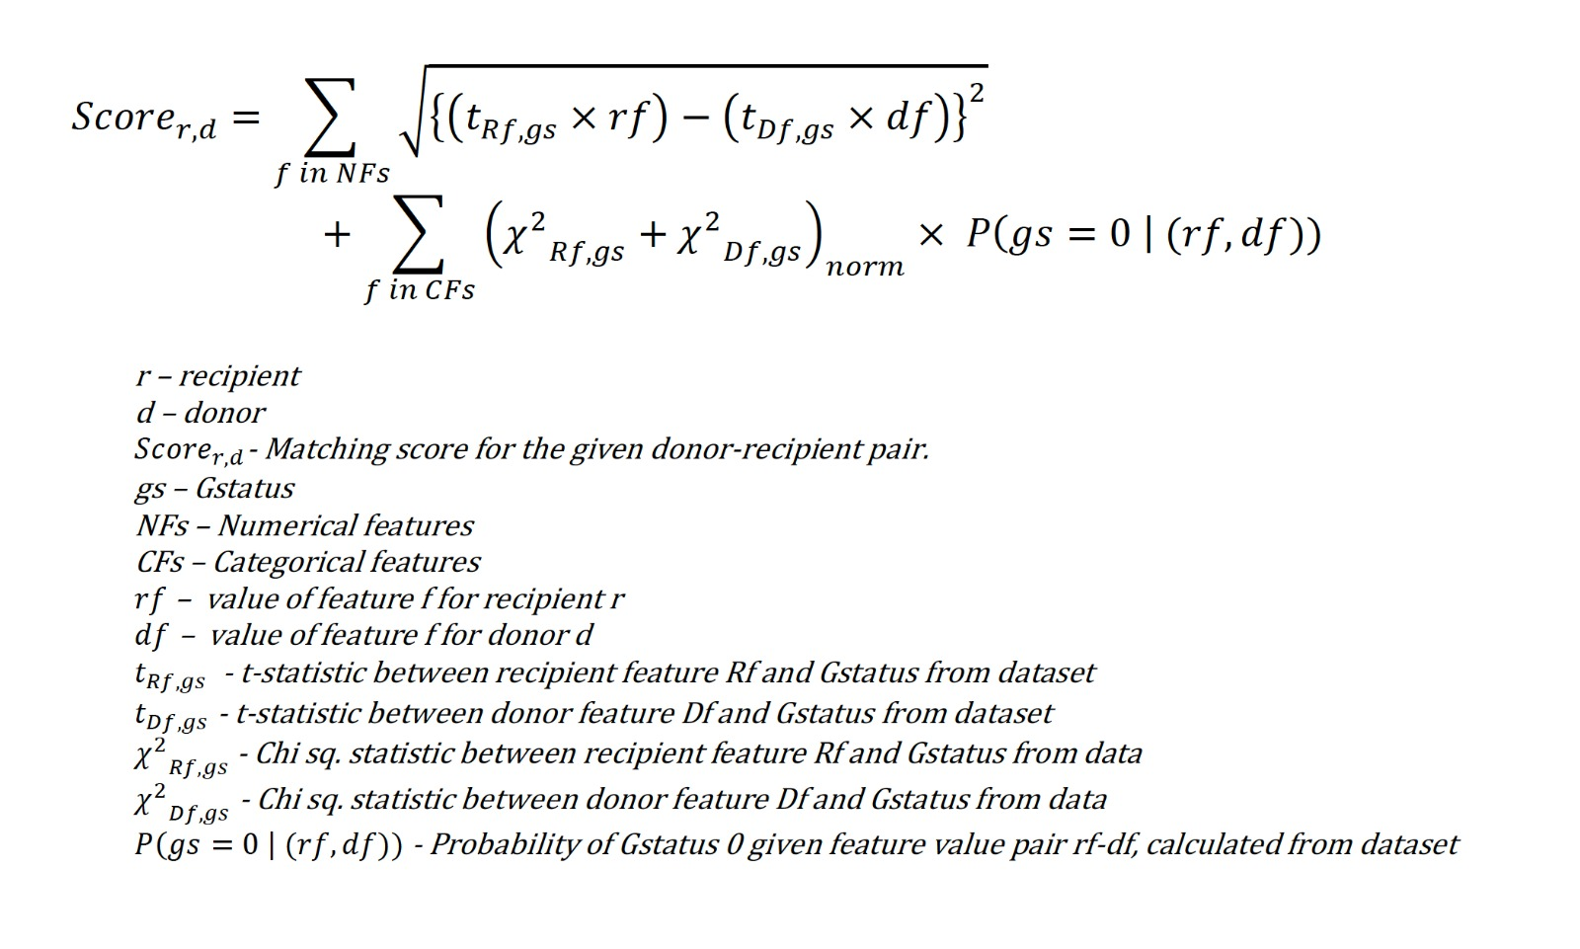
24

Slide 27
Part 4: Survival Prediction
25

Slide 28
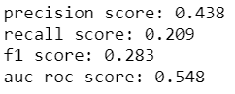
Random Forest
Random Forest predicts the probability of an outcome that can only have two values (i.e. a dichotomy). The prediction is based on the use of one or several predictors (numerical and categorical).
The data is split into training and test set with a ratio of 70:30
The target variable is GSTATUS. The input vector to the learning model is of dimensions (39162, 237). The output is a binary class - either 0 or 1.
Incorporated Over Sampling and Cross Validation techniques
Model Performance:
26

Slide 29
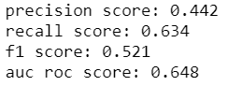
Logistic Regression
Logistic regression predicts the probability of an outcome that can only have two values (i.e. a dichotomy). The prediction is based on the use of one or several predictors (numerical and categorical).
The data is split into training and test set with a ratio of 70:30
The target variable is GSTATUS. The input vector to the learning model is of dimensions (39162, 237). The output is a binary class - either 0 or 1.
Incorporated Over Sampling and Cross Validation techniques
Model Performance:
27

Slide 30
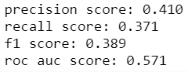
Deep Learning
Deep learning is a specific subfield of machine learning: a new take on learning representations from data that puts an emphasis on learning successive layers of increasingly meaningful representations.
Model Specifications:
Number of layers:7
Number of hidden units:5
Activation functions for input and hidden layers: relu
Activation functions for output layer: sigmoid
Batch Normalization and drop out layers are added
Model Performance:
28

Slide 31
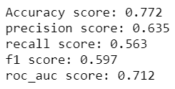
Ensemble Model
Ensemble methods are meta-algorithms that combine several machine learning techniques into one predictive model in order to decrease variance(bagging), bias (boosting), or improve predictions (stacking).
We are combining Random Forest, Logistic Regression and Deep Learning in order to build a more efficient prediction Model using predict probability function.
29

Slide 32
Performance Metrics
F1 SCORE: F1 score is a measure of a test's accuracy. It considers both the precision and recall to compute the score. The F1 score is the harmonic average of the precision and recall, where an F1 score reaches the best value at 1 and worst at 0.
AUC ROC SCORE: The ROC curve is created by plotting the true positive rate (TPR) against the false positive rate (FPR) at various threshold settings.
MATCHING SCORE: The model develops a matching score for a donor and a recipient. This matching score must be highly correlated with the survival rate.
30

Slide 33

Cross-Validation
Strategy: K-Fold Cross Validation
As there is never enough data to train your model, removing a part of it for validation poses a problem of underfitting. By reducing the training data, we risk losing important patterns/ trends in data set. So, what we require is a method that provides ample data for training the model and also leaves ample data for validation. K Fold cross validation does exactly that.
Risk: This increased the computation time required to train the model.
Result: This significantly reduces bias as we are using most of the data for fitting, and also significantly reduces variance as most of the data is also being used in validation set.
31

Slide 34
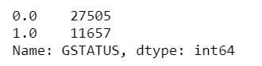
Over-Sampling
Strategy: SMOTE algorithm is used to address the imbalance in the dataset.
Risk: It was a challenge to perform SMOTE with cross validation and to ensure no information about test data was leaked to the model during the training phase.
Result: SMOTE is an oversampling technique that generates synthetic samples from the minority class. It is used to obtain a synthetically class-balanced or nearly class-balanced training set, which is then used to train the classifier.
.
32

Slide 35
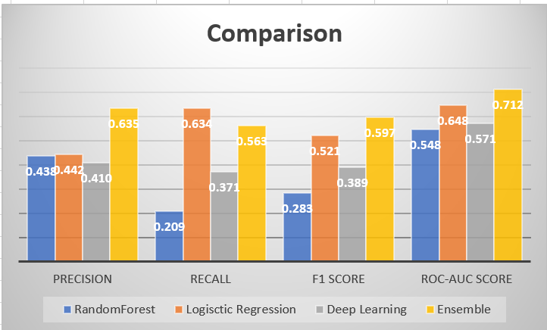
33

Slide 36
Part 5: User Interface

Slide 37
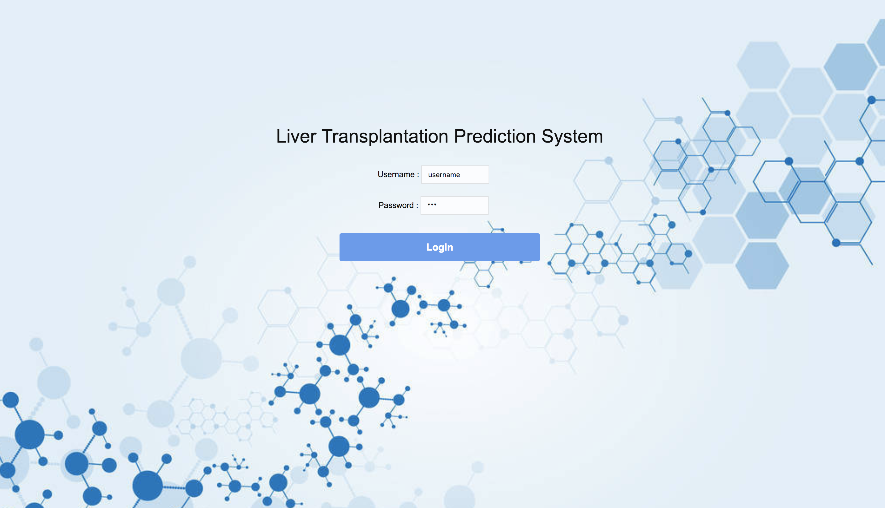

Slide 38
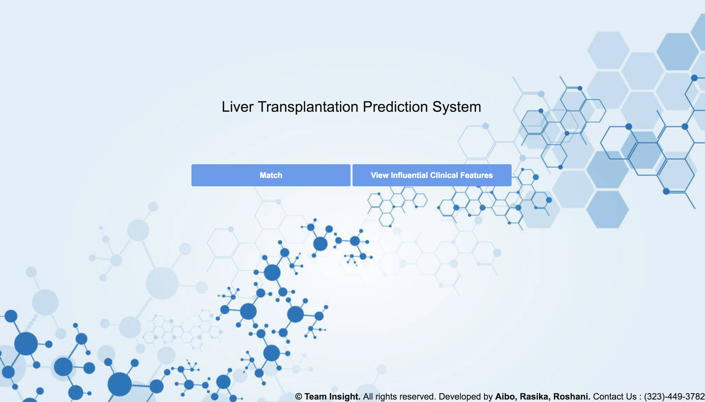

Slide 39
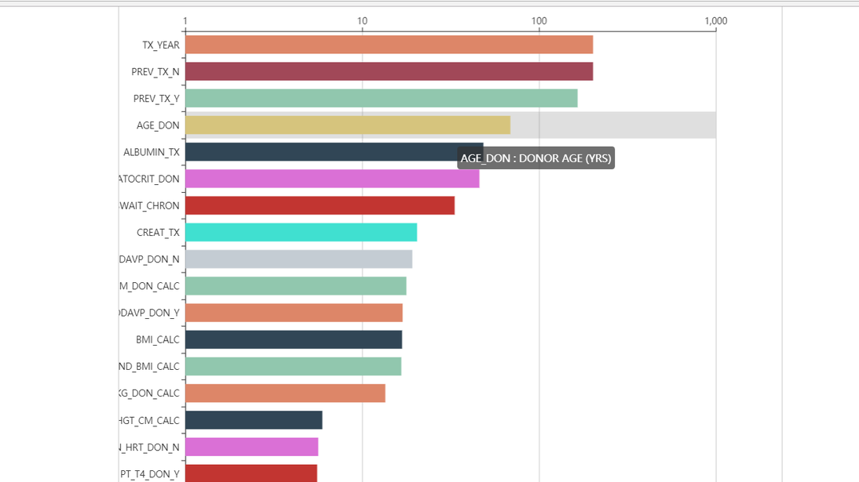

Slide 40
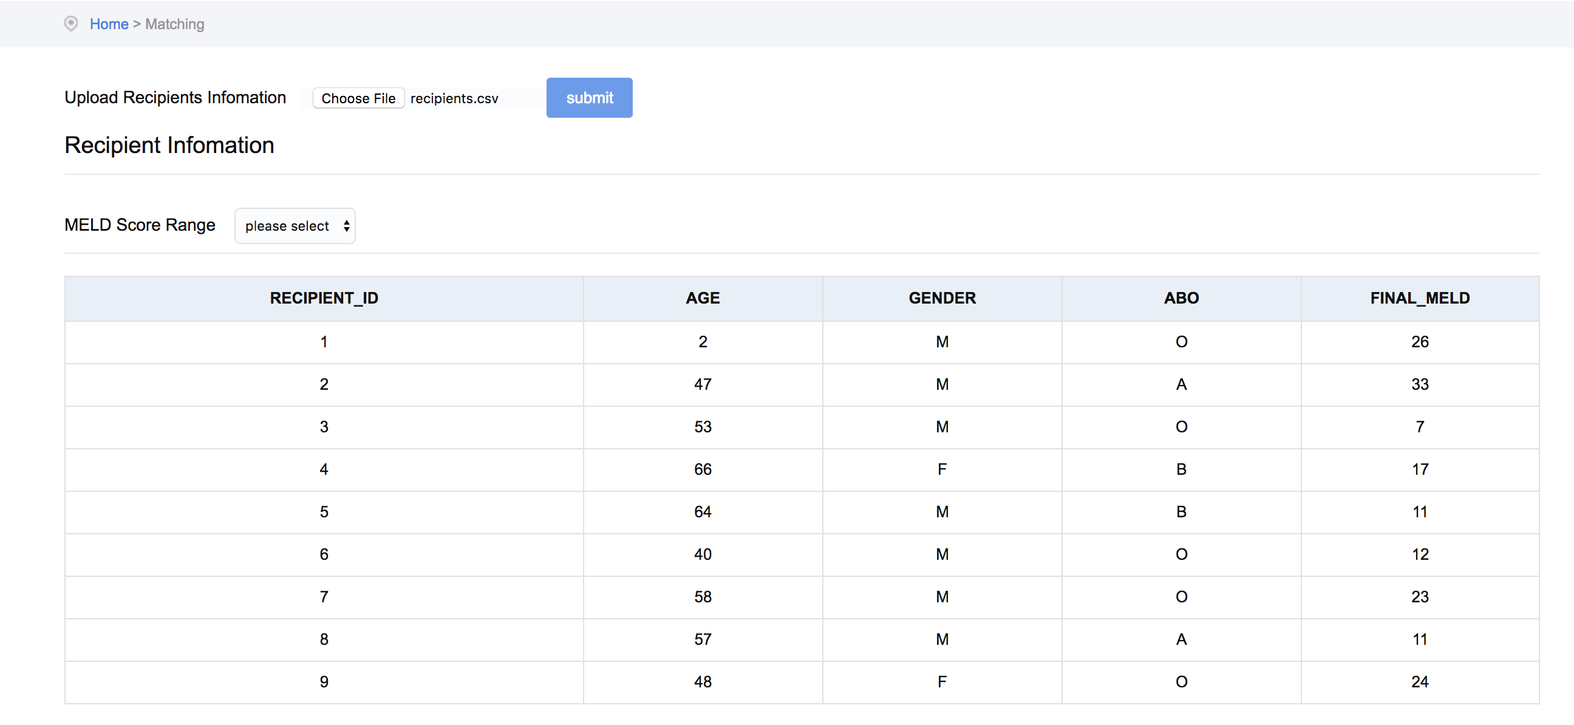

Slide 41
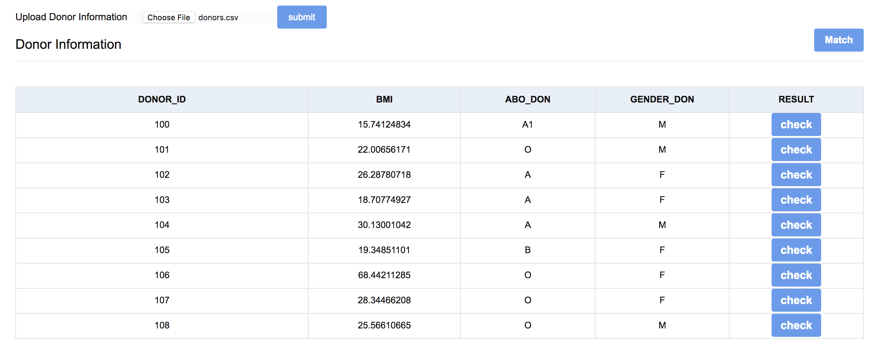

Slide 42
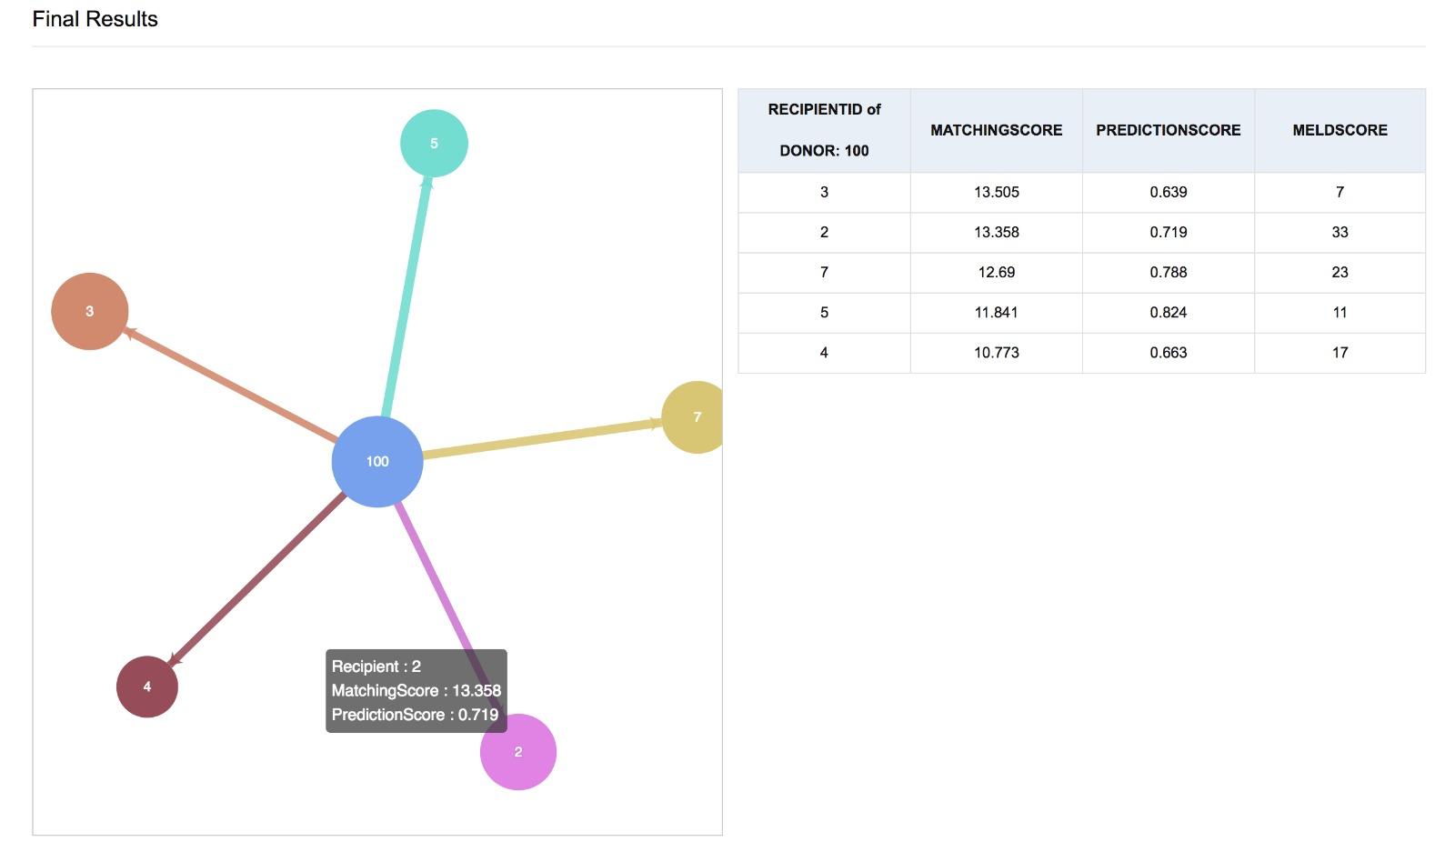

Slide 43

Test Scenario
On every encounter of a new Liver Donor or a Liver recipient, a medical expert enters their clinical information in the donor and recipient file respectively.
In order to identify the potential recipient for the newly added Donor,
Dr. Peter logs in to the Liver Prediction System using his login credentials and uploads the following files
CSV file for donor with their clinical information
CSV file for recipient with their clinical information
And selects the desired MELD score range
Dr. Peter then clicks on ‘match’ to match all the existing donors with potential recipients. He then can view the top 5 potential recipients for every donor by clicking on “check” option. Dr. Peter can also view the top 20 influential clinical features involved in the predictive analysis.
Output:
1. Top 20 clinical features that influence the identification of potential recipient.
2. The top 5 recipients for every donor can be viewed along with the matching and graft prediction scores of each recipient.
34

Slide 44
Mistake Proofing
The web application developed is to be used only by the medical experts. We are ensuring this by creating a login system.
The user needs to upload the donor and recipient information file in order to view the results. The system throws a warning in case no file is uploaded.
The sample format for donor and recipient file is provided. The machine learning model is trained to handle if there is any addition of previously unseen feature in the input file or if any of the expected donor/recipient features are missing in the file.
35

Slide 45
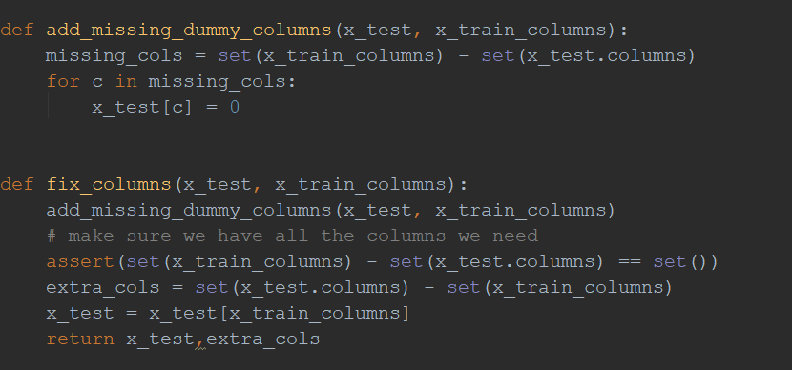
Mistake Proofing
Challenge: The Machine learning models were trained based on certain input features and the model would fail if the test data had different set of features.
Solution: We ensured that the test data had same set of features as train data by incorporating the following code
36

Slide 46

Project Close-out
User manual containing the guidelines on how to use the web application, the input and output expected out of the system is handed over to the end-user
Project close out includes the delivery of Project Documentation, read-me file and Web Application to the end user
37

Slide 47
DEMO
38

Slide 48
Key Learnings
Delivering a product to the customers by adopting six sigma principles and techniques.
Collaborating with team members and keeping up with timelines.
Working with private patient information by incorporating the learnings from HIPPA training
Implementing a full-fledged machine learning project on a real world health care data
39

Slide 49
Future Work
The Web application can be hosted publicly (AWS server)
Database can be used for the storage of Donor and Recipient information
Login system can be implemented to restrict the usage of web application to Keck School of Medicine, USC
40

Slide 50
References
https://dsi.usc.edu/application-domains/health/
https://www.uptodate.com/contents/model-for-end-stage-liver-disease-meld
https://www.uptodate.com/contents/liver-transplantation-donor-selection
http://primarycare.imedpub.com/machine-learning-in-the-prediction-of-costs-forliver-transplantation.php?aid=20930
https://www.uptodate.com/contents/model-for-end-stage-liver-disease-me
https://pdfs.semanticscholar.org/c5a9/67eaded74a9fc414de4ad5120b0b66acd2c3.pdf
https://www.omicsonline.org/open-access/artificial-neural-networks-in-prediction-of-patient-survival-after-liver-transplantation-2157-7420-1000215.php?aid=67545
https://www.uptodate.com/contents/liver-transplantation-donor-selection/
https://doi.org/10.1371/journal.pone.0186301
41

Slide 51


